Slide 1
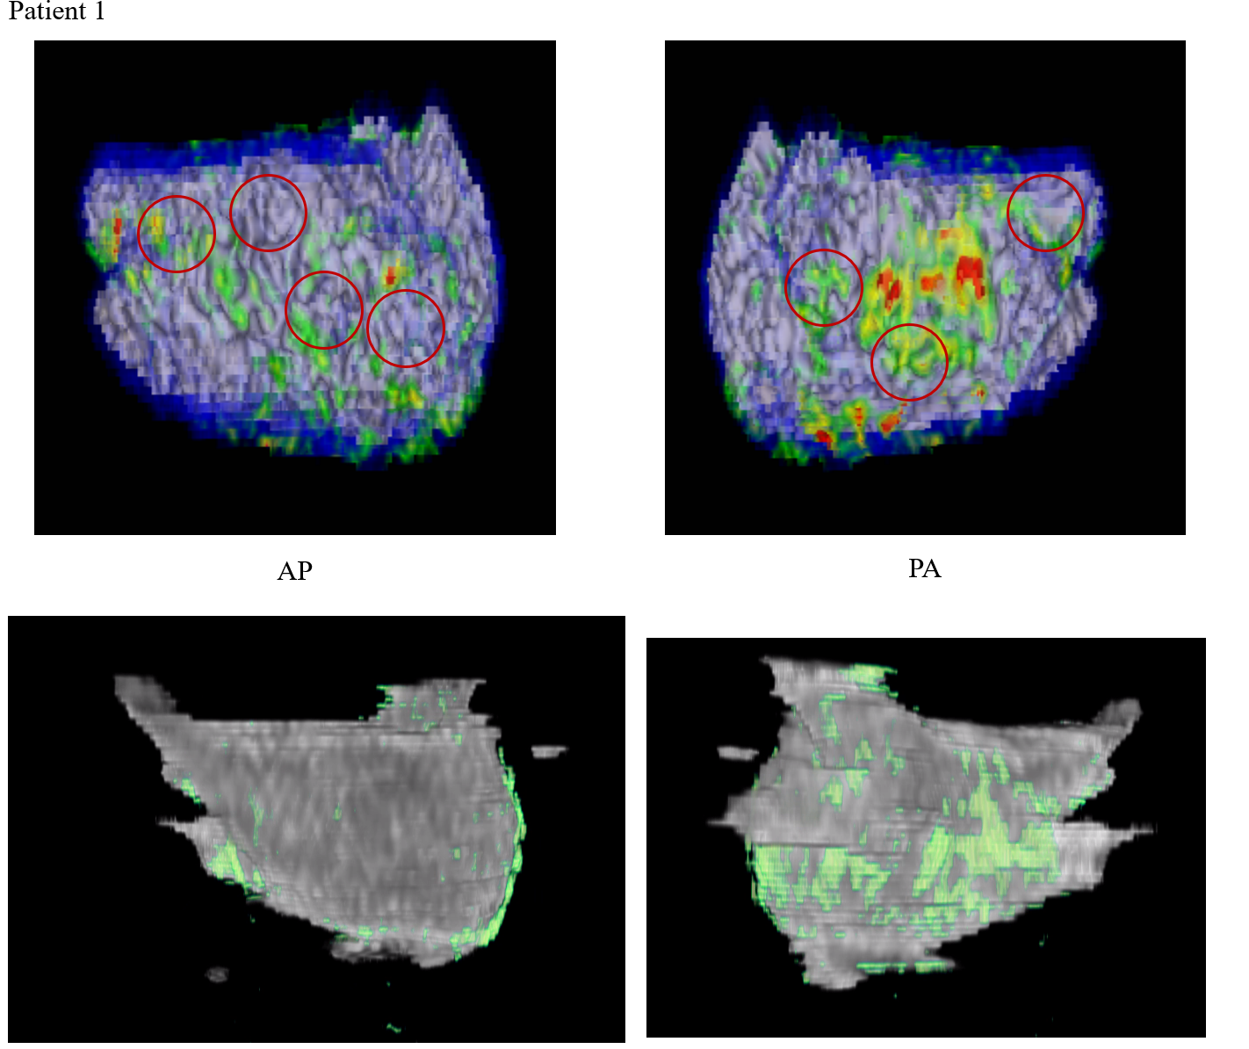
LA Fibrosis:
15.9 %

Slide 2
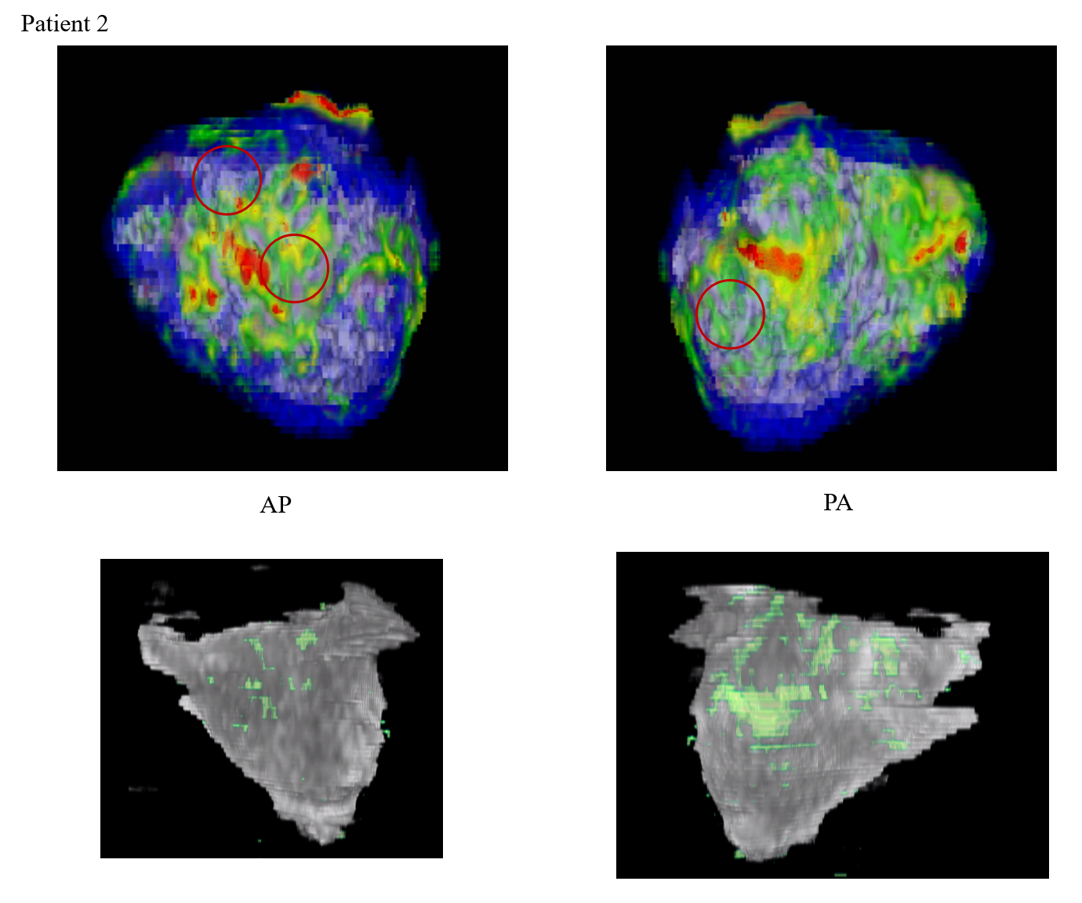
LA Fibrosis:
5.5 %

Slide 3
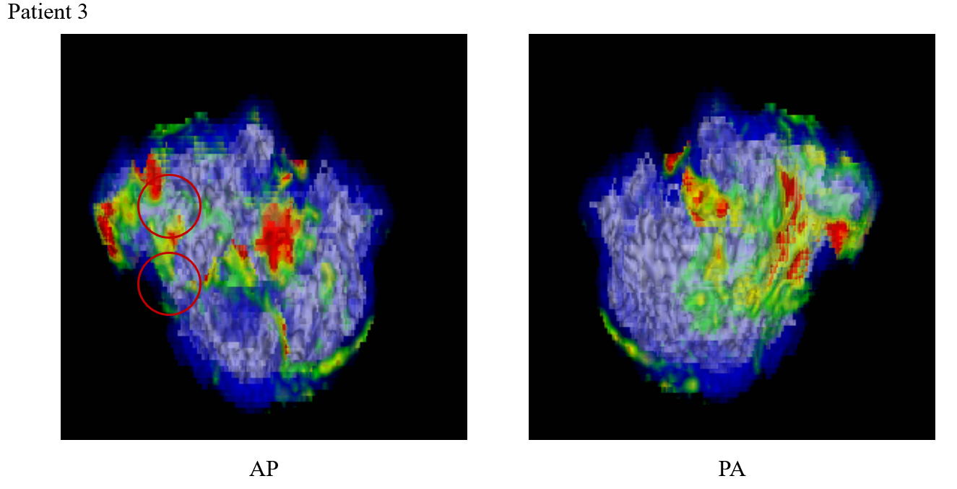
Bad segmentation due to bad image

Slide 4
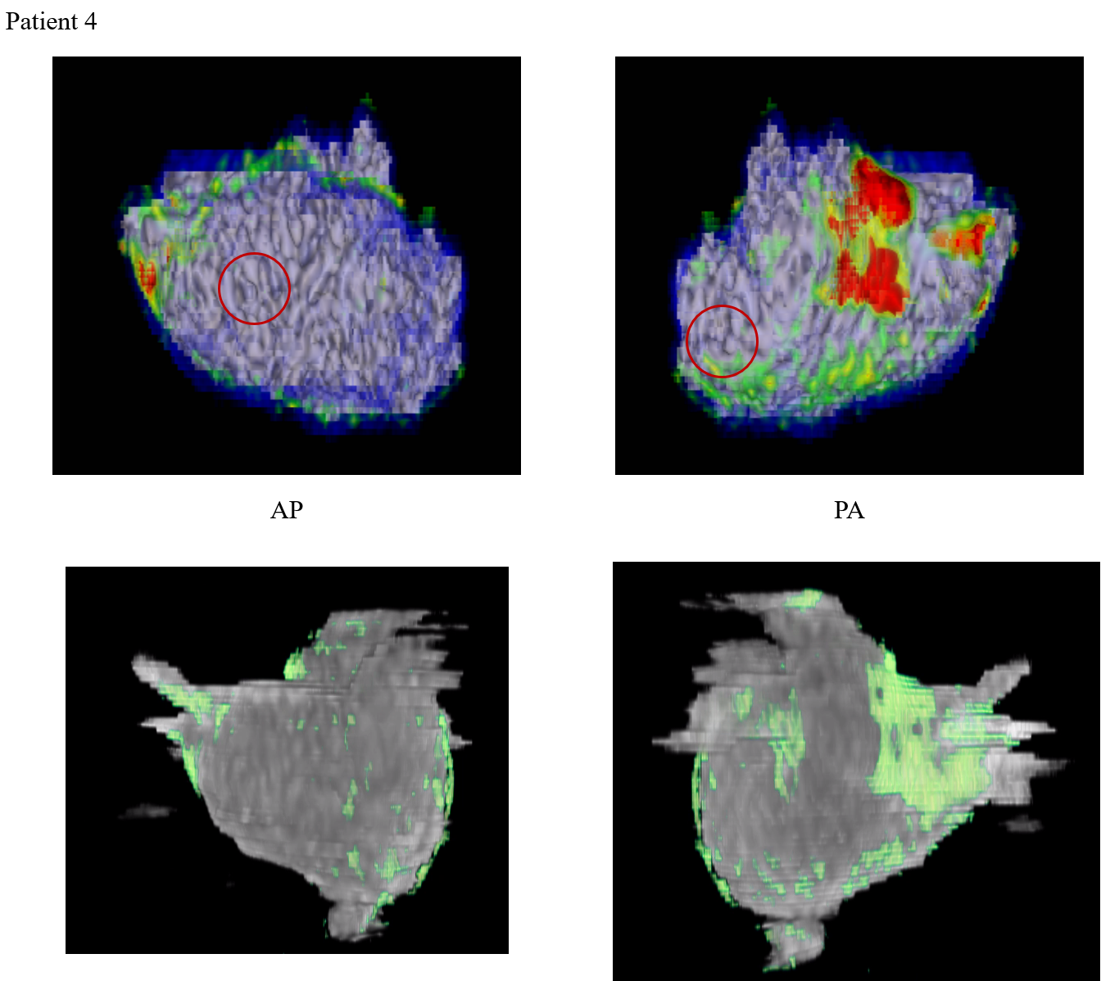
LA Fibrosis: 15.9 %

Slide 5
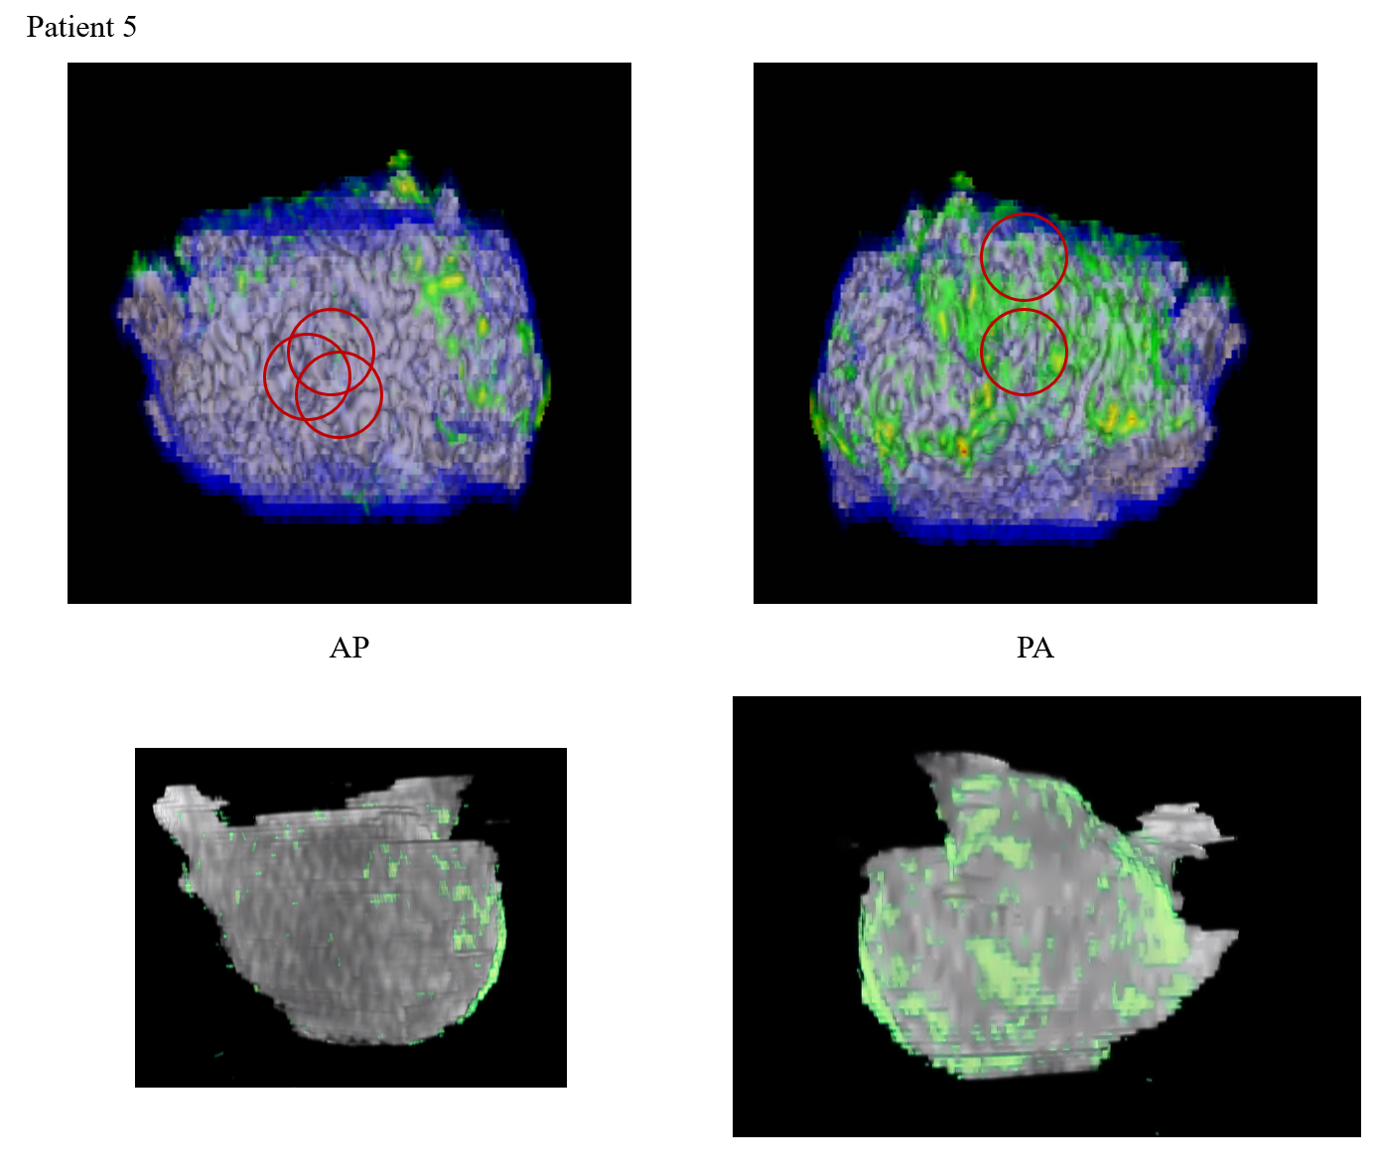
LA Fibrosis:
16.3 %

Slide 6
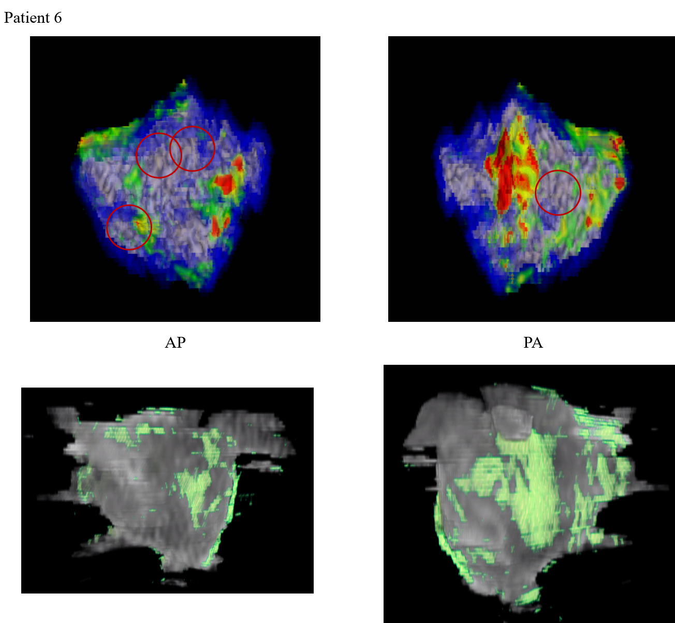
LA Fibrosis:
19.4 %

Slide 7
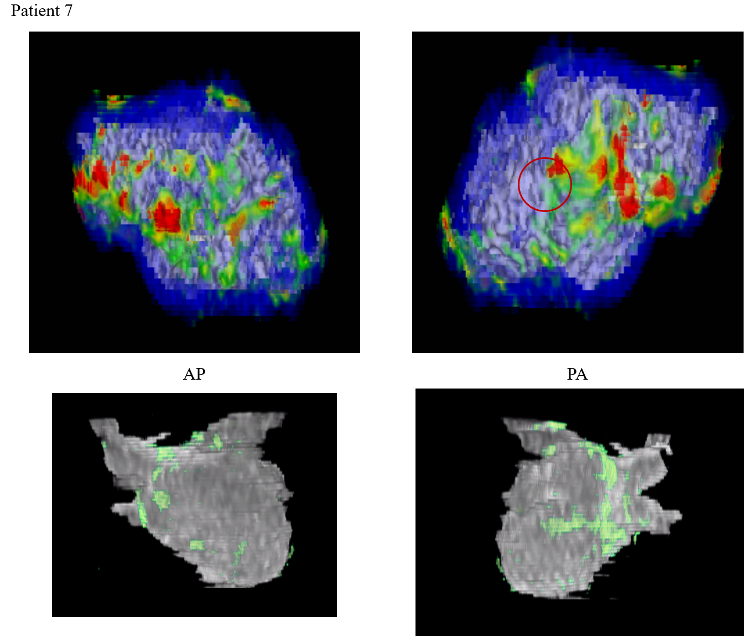
LA Fibrosis: 9.4 %

Slide 8
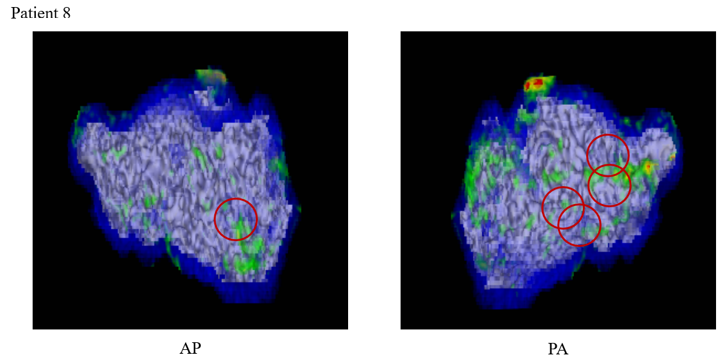
No Data for Prediction

Slide 9
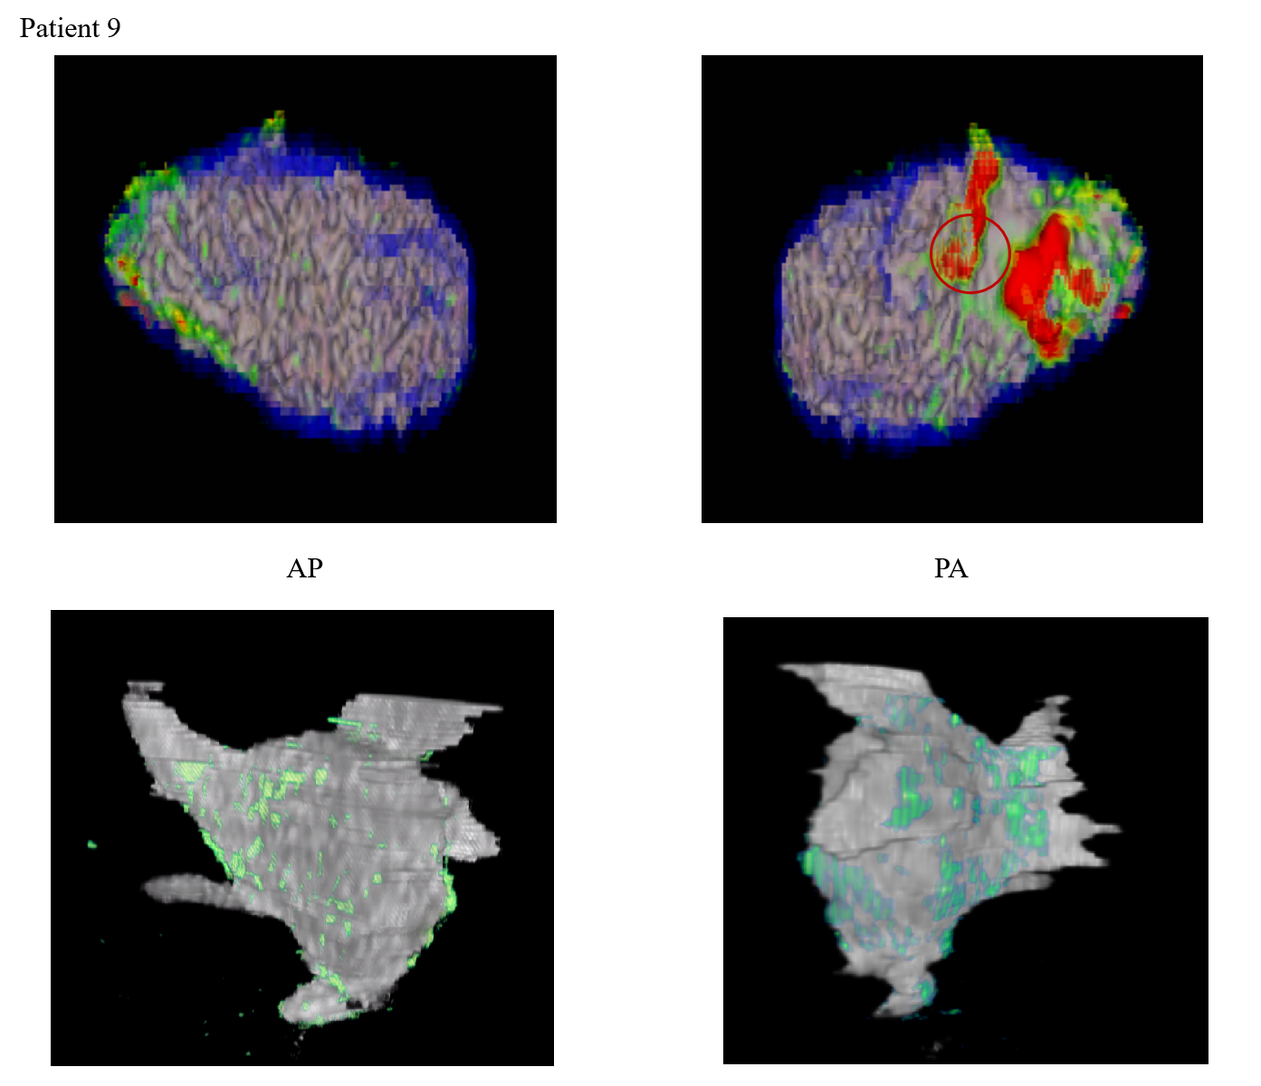
LA Fibrosis:
21.4 %

Slide 10
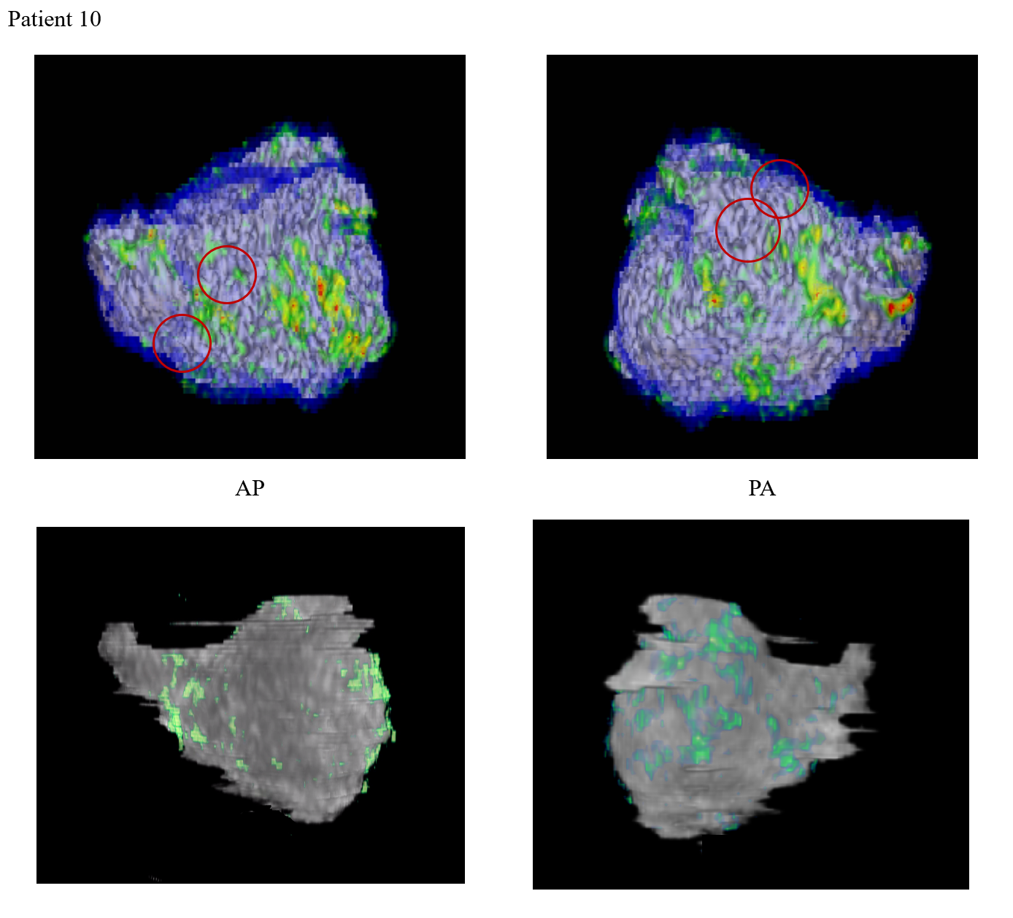
LA Fibrosis: 16.5 %

Slide 11
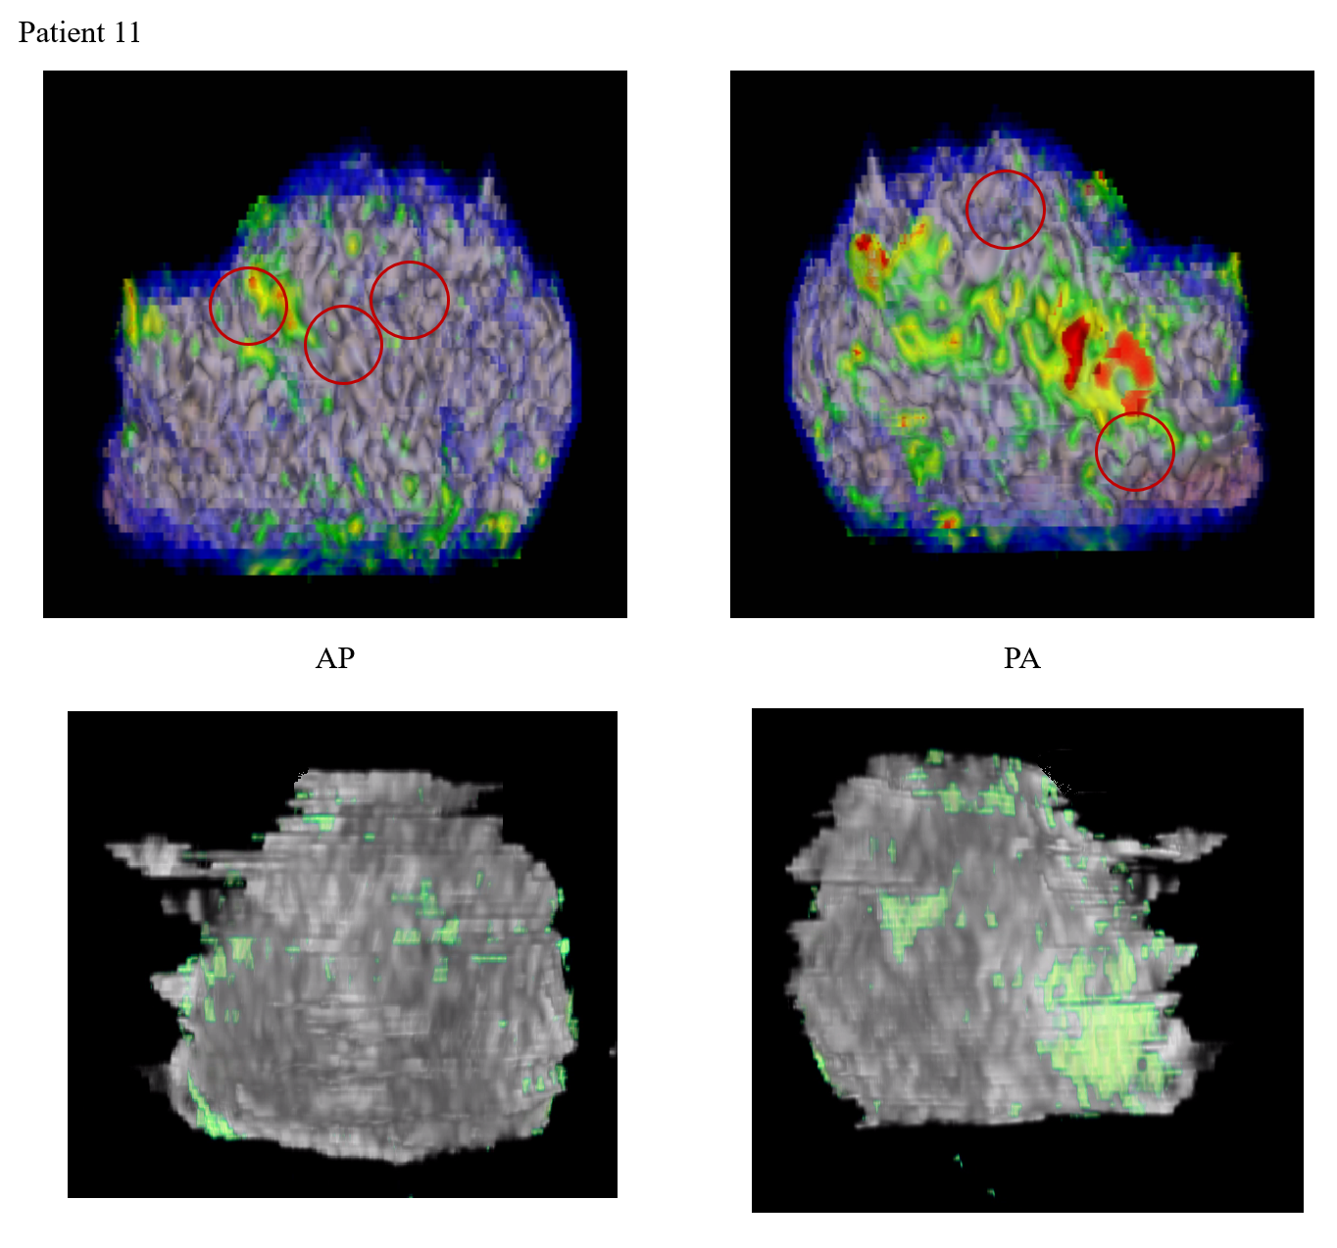
LA Fibrosis:
9.4 %

Slide 12
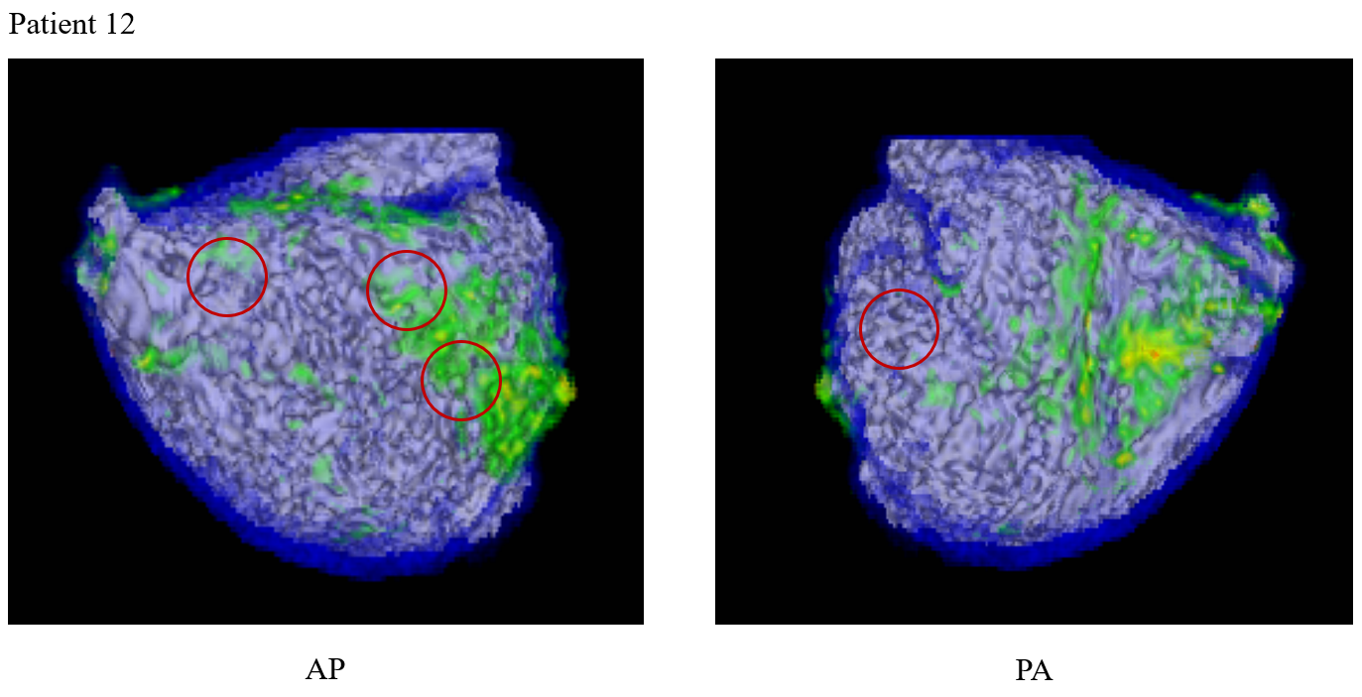
No Data for Prediction

Slide 13
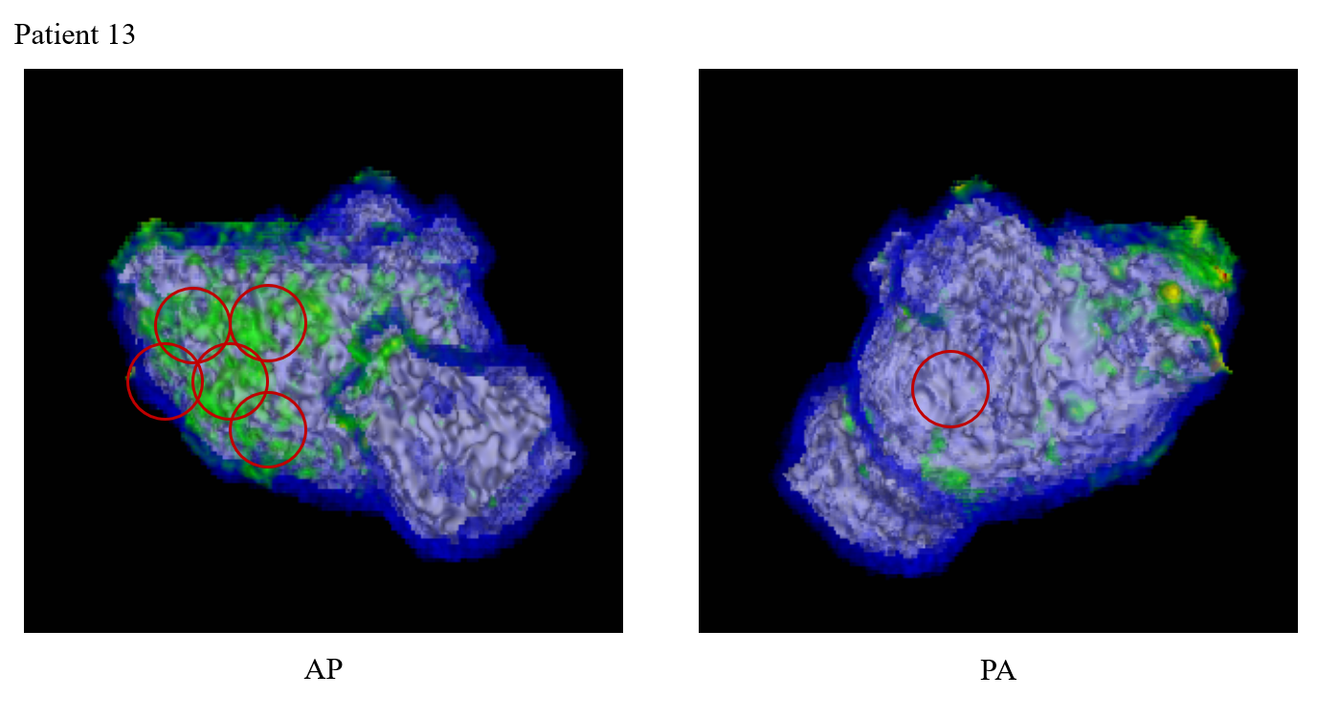
No Data for Prediction

Slide 14
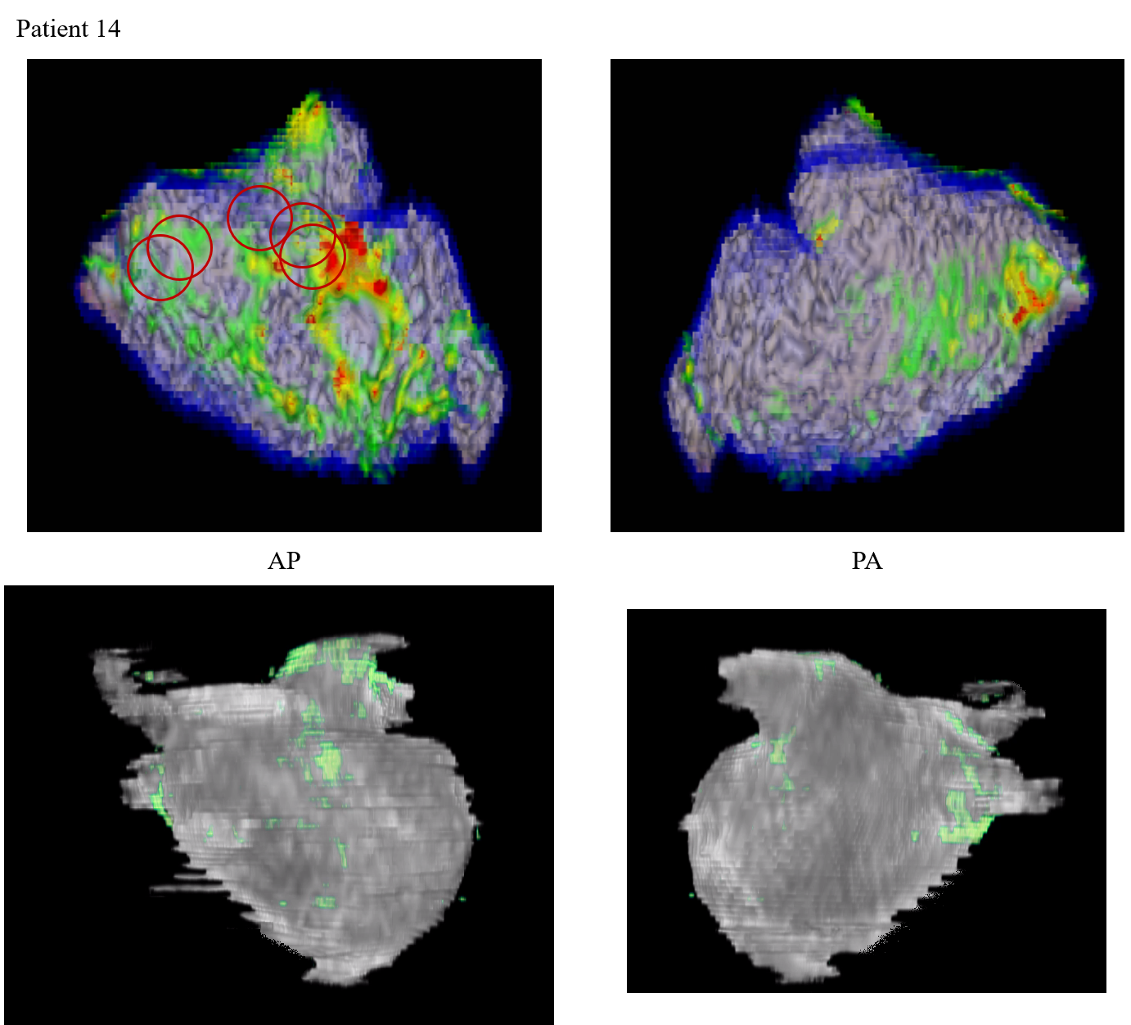
LA Fibrosis:
5.9 %

Slide 15
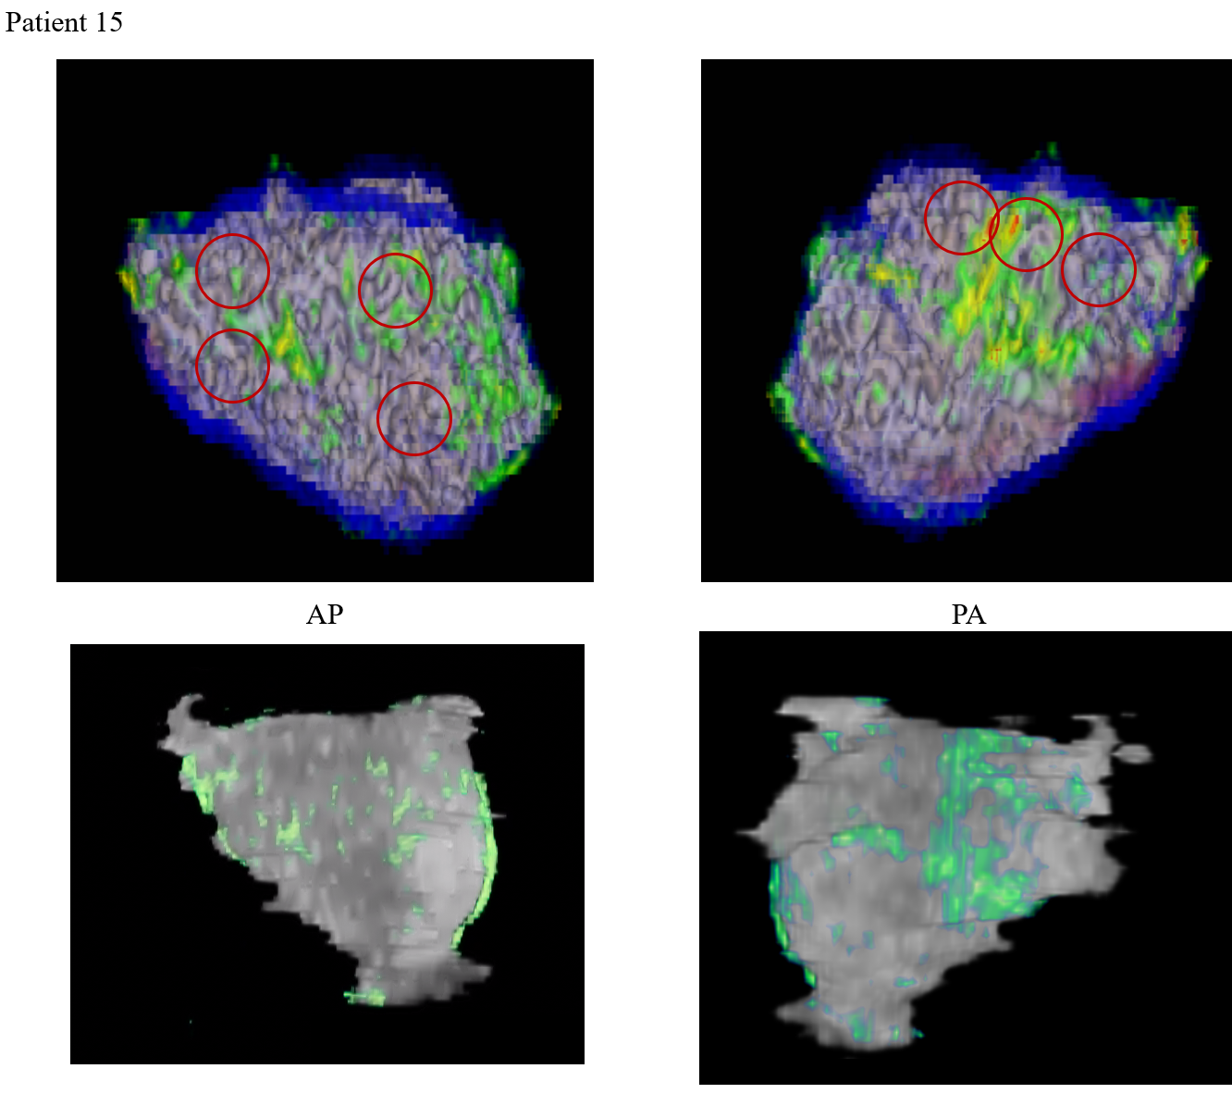
LA Fibrosis:
22.2 %

